Slide 1
Employment in Manufacturing and Monetary Policy: Cyclical and Structural Factors
International Atlantic Economic Society
Lisbon Conference
March 17, 2016
Merton Finkler, Ph.D
Professor of Economics
Lawrence University

Slide 2
Money: Setting the Mood
Money: “a blessing that is of no advantage to us excepting when we part with it. An evidence of culture and a passport to polite society. – The Devil’s Dictionary, A. Bierce
“Cheap money can’t buy a strong economy” – R. Samuelson

Slide 3
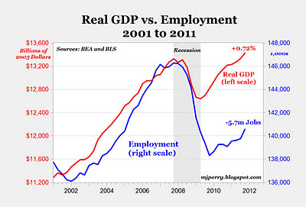
Notes:
The 2001 and 2007-2009 recession have been called jobless recoveries

Slide 4
Notes:
Relative factor prices have changed, and as a result, equipment purchases rose relative to employment.

Slide 5
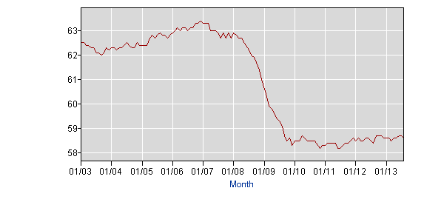
Employment/ Population Ratio
Notes:
In terms of recovery in general, employment relative to the eligible population has barely moved since 2009.

Slide 6
Pertinent Literature
Papers related to Okun’s Law, – Knotek (KC Fed – 2007 and 2009) – monetary policy and unemployment rates
Jaimovich & Siu and Autor on increasing polarization in labor markets
Competitive equilibrium in capital markets forces MPK to align with real interest rates; thus, either capital must increase or employment must decline – Gavin (2013)
Dynamics of employment and unemployment – Shimer (2012)
None directly relate monetary policy to changes in employment in general or to manufacturing in particular.

Slide 7
Federal Reserve Bank’s Mandate
The Dual Mandate as stated by the 1977 Congressional amendment to the Federal Reserve Act
“The Board of Governors of the Federal Reserve System and the Federal Open Market Committee shall maintain long run monetary policy and credit aggregates commensurate with the economy’s long run potential to increase production, so as to promote effectively the goals of maximum employment, stable prices and moderate long term interest rates”
“The maximum level of employment is largely determined by non-monetary factors that affect the structure and dynamics of the labor market” – Statement of Longer Run Goals and Monetary Policy Strategy – 1/25/12 & amended 1/26/16

Slide 8
Targets for Specification
Kocherlakota (2012): Both labor demand and product demand should be central to macroeconomic stabilization policy.
Profit maximization → factor choice depends upon factor prices. Here the choice is between labor and labor-saving equipment.

Slide 9
Research Question
How are changes in employment in manufacturing related specifically to product demand and labor demand components?
Product demand includes both direct and indirect indicators
Labor demand incorporates substitution between labor and capital based on relative factor prices

Slide 10
Specification to be Estimated
Net Job Gains_{t} = constant + α*(Unit Labor Cost_{t}) + β*(Price of Equipment_{t}) +γ*(Value Added_{t}) + δ*(Borrowing Rate_{t}) + θ*(Price of Capital_{t}*Borrowing Rate_{t}) + μ*(Fedfunds_{t}) + ε_{t}
where t reflects the specific time period.
Specifications are based on cost of adjustment with lags for ULC, price of equipment, and value added
Various lag structures without much change
Regression based on data from Q3:1992 to Q1:2012

Slide 11
Data Sources
Quarterly changes in manufacturing employment – Business Employment Dynamics Survey , not monthly household or payroll surveys (all BLS surveys). Series began in Q3:1992 and represents 98% of employment on private, non-farm payrolls
BEA provides quarterly price index for equipment
BLS provides a monthly unit labor cost index – middle month selected
BEA calculates value added by industry on an annual basis – smoothed to generate quarterly entries
Moody’s interest rate on bonds rated Baa (available daily, used middle month) – to represent borrowing rate
Fed funds rate – middle month selected

Slide 12
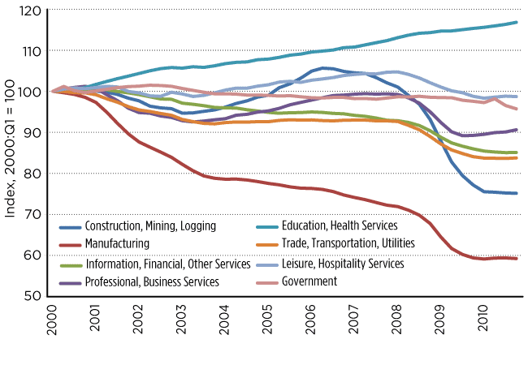
Indices of Employment by Sector – St. Louis Federal Reserve Annual Report 2010
Notes:
Manufacturing employment has declined since 1955 with the rate of decline increasing during recessions.

Slide 13
Unit Labor Cost
Notes:
Note the rapid decline in the 1990s which coincided with large increases in employment, and the rise from 2007 to 2010.

Slide 14
Manufacturing
Manufacturing accounts for about 8.7% of non-farm employment and 12.1% of gross domestic product.
Labor demand decision-making includes response to the ratio of the labor compensation divided by labor productivity = unit labor cost.

Slide 15
Manufacturing Sector Regression Analysis
Dependent Variable: M_NJOBCH | (1) | (2) | (3)
Unit labor cost (1Q lag) | NA | -19.1 (9.8)* | -24.9 (9.2)**
Value Added (1Q lag) | -.033 (.018) | -.030 (.017) | -.014 (.015)
Value Added (2Q lag) | .035 (.026) | .040 (.019)* | .026 (.018)
Eqpt Prices (1Q lag) | -54.39 (20.85)** | -20.9 (4.27)** | -61.0 (20.9)**
Moodys Baa | -946.4 (274.4)** | NA | -1073.5 (273.4) **
Capital Cost | 8.22 (2.67)** | -.89 (.23) | 9.55 (2.67)**
Fed Funds Rate | 20.16 (11.1) | NA | 2.87 (13.2)
Constant | 6117.8 (2113.4)** | 195.6 (651.3) | 9108.8 (2289.6)**
Adjusted R² | .427 | .371 | .485
* statistically significant the 5% level, ** statistically significant at the 1%

Slide 16
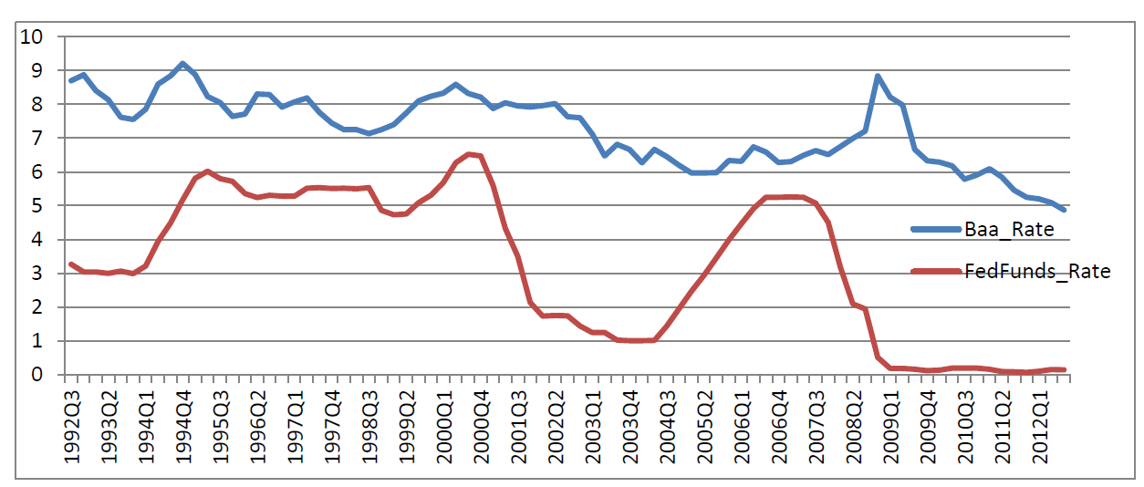
Moodys Baa Corporate Rate vs. the Federal Funds Market Rate
Notes:
The cost of borrowing firms face is not closely linked to the Federal Funds market rate of interest, especially since 2000.

Slide 17
Discussion of Results
A 1 standard deviation ↑ in unit labor cost (2.7 units) → a decline of 68,000 jobs
Capital costs do matter for firms with both short term and long term effects. A 1 standard deviation ↑ in each of the 3 cost terms yields a net loss of over 96,000 jobs. Sign opposite that expected.
Employment results are consistent with Levine (2013): 20 to 50% of the rise in unemployment between 2007 and 2010 was structural – not related to search or cyclical forces.
Notes:
Two terms with negative signs yield a decline of 1750.2 while the positive adds 1654.0 for a net loss of 96.2 (thousand)

Slide 18
Implications
A stable relationship between GDP growth and employment growth depends upon a stable relationship between the cost of labor and the cost of capital.
The most recent business cycle featured significant changes in factor prices in opposite directions which affected both the growth rate and the mix of labor and equipment in manufacturing.
Aggressive monetary policy along with uncertainty regarding the prospective cost of labor provided reasons to substitute capital (especially equipment and software) for labor.

Slide 19
More Implications
A sustained very low or negative real interest rate: interest rate - expected(inflation) < 0 - distorts decision-making
Decisions affected include
Saving vs. Borrowing
Portfolio and Pension Management
Domestic vs. International Capital Flows as well as Net Exports
Labor vs. Leisure (including retirement)
Allocation of Employment Across Sectors

Slide 20
Conclusions
The FOMC policy statement (12/12/12) that based monetary policy on a specific rate of unemployment (6.5%) did not satisfy the maximum employment criterion. In April 2014, the FOMC removed reference to a specific unemployment rate target.
Policies to increase employment should be focused on reducing the relative price of labor and such policies are beyond the options available to the Fed.
Financial repression, especially if real rates of interest are negative for a long time, distorts decision-making in the direction of excessive capital expansion and leveraging with consequences for the future stability of the economy.

